Slide 1
Sales Report 2021
Jan 2022

Slide 2

Agenda
Annual sales performance breakdown
Sales trend

Slide 3
Overview
Strengths
Weaknesses
Majority sales amounts between $5000 to $20000
56% met the minimum $15000 target sales
Inconsistent Sales
Certain areas and employees weak in sales
Externl

Slide 4
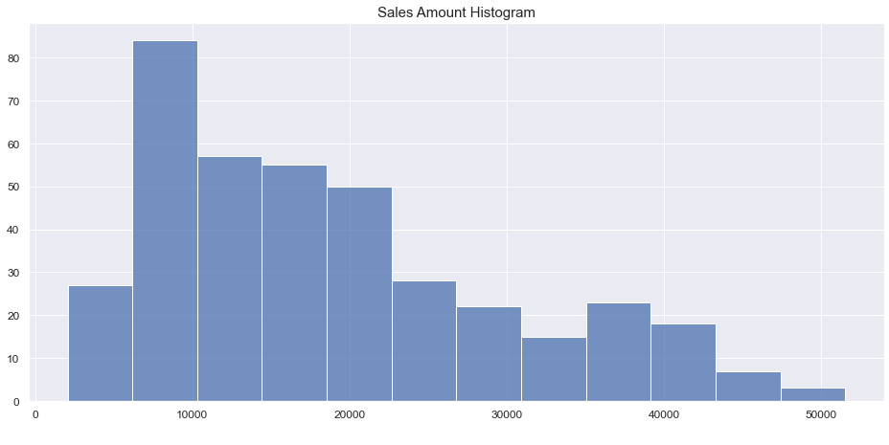
Strengths
Majority sales amounts between $5000 to $20000

Slide 5
Concerns
Period
Area
Employees
May to August lowest sales recorded
South and West problematic
Slightly more than half perform better

Slide 6
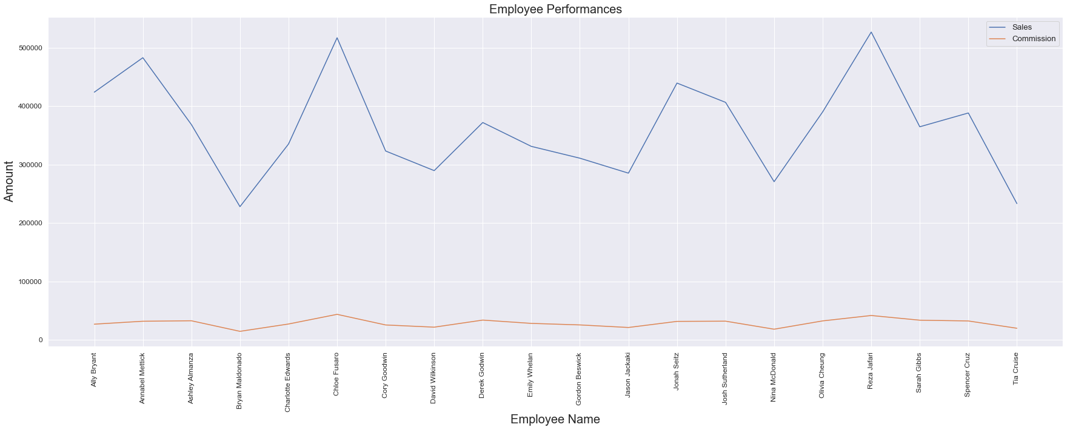
Employee Performances

Slide 7
Thanks
Do you have any questions?
XYZ Company

